Slide 1




Noida Institute of Engineering and Technology, Greater Noida (An Autonomous Institute) School of Computer Science & Engineering in Emerging Technologies
JavaScript Essentials and ES6
Unit: 4
Subject Name:
WEB TECHNOLOGY (ACSE0505) )
Mr. Amar Pal Yadav
Assistant Professor
CSE & ET (AI Department)
Course Details (B Tech. 5th Sem)

Slide 2

Table of Contents
Name of Subject with code, Course and Subject Teacher
Brief Introduction of Faculty member with Photograph
Evaluation Scheme
Subject Syllabus
Branch wise Applications
Course Objective (Point wise)
Course Outcomes (COs)
Program Outcomes only heading (POs)
COs and POs Mapping
Program Specific Outcomes (PSOs)
2

Slide 3
Conti….
COs and PSOs Mapping
Program Educational Objectives (PEOs)
Result Analysis (Department Result, Subject Result and Individual Faculty Result)
End Semester Question Paper Templates (Offline Pattern/Online Pattern)
Perquisite/ Recap
Brief Introduction about the Subject with videos
Unit Content
Unit Objective
Topic Objective/Topic Outcome
Lecture related to topic
Daily Quiz
Weekly Assignment

Slide 4
Conti…
Topic Links
MCQ (End of Unit)
Glossary Questions
Old Question Papers (Sessional + University)
Expected Questions
Recap of Unit
4

Slide 5
Brief introduction of faculty Member
Mr. Amar Pal Yadav
Designation: Assistant Professor CSE&ET (AI )
NIET, Greater Noida (Code-133)
Qualification:
B.Tech(IT)
M.Tech(SE), Specialization: Software Engineering
Teaching Experience: 12 years
Research Publication
Paper Published: 8(International Journal)
Coursera Course
Coursera Course Completed: 15
5

Slide 6
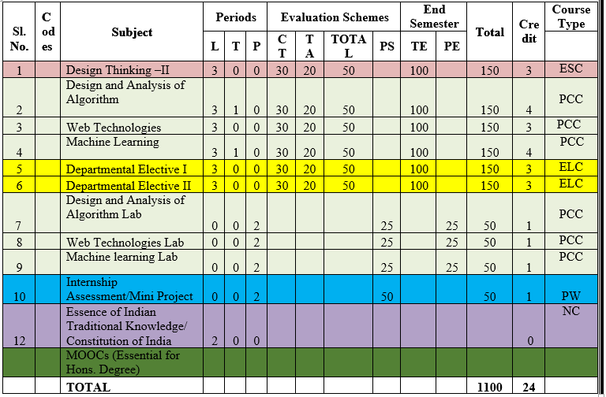
Evaluation Scheme

Slide 7
Syllabus Unit -1
Introduction: Introduction to Web Technology, History of Web and Internet, Connecting to Internet, Introduction to Internet services and tools, Client-Server Computing, Protocols Governing Web, Basic principles involved in developing a web site, Planning process, Types of Websites, Web Standards and W3C recommendations.
Web Hosting: Web Hosting Basics, Types of Hosting Packages, Registering domains, Defining Name Servers, Using Control Panel, Creating Emails in Cpanel, Using FTP Client, Maintaining a Website.

Slide 8
Syllabus Unit -2
HTML: What is HTML, DOM- Introduction to Document Object Model, Basic structure of an HTML document, Mark up Tags, Heading-Paragraphs , Line Breaks, Understand the structure of HTML tables. Lists, Working with Hyperlinks, Image Handling, Understanding Frames and their needs, HTML forms for User inputs. New form Elements- date, number, range, email, search and data list, Understanding audio, video and article tags.
XML: Introduction, Tree, Syntax, Elements, Attributes, Namespaces, Display, HTTP request, Parser, DOM, XPath, XSLT, XQuerry, XLink, Validator, DTD, Schema, Server

Slide 9
Syllabus Unit -3
Concept of CSS 3: Creating Style Sheet, CSS Properties,CSS Styling(Background, Text Format, Controlling Fonts) , Working with block elements and objects , Working with Lists and Tables , CSS Id and Class, Box Model(Introduction, Border properties, Padding Properties, Margin properties) CSS Advanced(Grouping, Dimension, Display, Positioning, Floating, Align, Pseudo class, Navigation Bar, Image Sprites, Attribute sector) , CSS Color, Creating page Layout and Site.
Bootstrap: Introduction, Bootstrap grid system, Bootstrap Components.

Slide 10
Syllabus Unit -4
JavaScript Essentials: Introduction to Java Script , Java script Types , Var, Let and Const Keywords, Operators in JS , Conditions Statements , Java Script Loops, JS Popup Boxes , JS Events , JS Arrays, Working with Arrays, JS Objects ,JS Functions , Using Java Script in Real time , Validation of Forms, Arrow functions and default arguments, Template Strings, Strings methods, Callback functions,
Object de-structuring, Spread and Rest Operator, Typescript fundamentals, Typescript OOPs- Classes, Interfaces, Constructor etc. Decorator and Spread Operator,
Difference == & ===, Asynchronous Programming in ES6, Promise Constructor, Promise with Chain, Promise Race.

Slide 11
Syllabus Unit -5
Introduction to PHP, Basic Syntax, Variables & Constants, Data Type, Operator & Expressions, Control flow and Decision making statements, Functions, Strings, Arrays,
Working with files and directories: Understanding file& directory, Opening and closing, a file, Coping, renaming and deleting a file, working with directories, Creating and deleting folder, File Uploading & Downloading.
Session & Cookies: Introduction to Session Control, Session Functionality What is a Cookie, Setting Cookies with PHP. Using Cookies with Sessions, Deleting Cookies, Registering Session variables, Destroying the variables and Session.

Slide 12
Text Books
Text books:
1. Steven M. Schafer, “HTML, XHTML, and CSS Bible, 5ed”, Wiley India
2. Ian Pouncey, Richard York, “Beginning CSS: Cascading Style Sheets for Web Design”, Wiley India

Slide 13
Branch Wise Applications
Sample Applications
Desktop GUI Applications
Mobile Applications
Enterprise Applications
Scientific Applications
Web-based Applications
Cloud-based Applications
Web servers and Application servers
Software Tools

Slide 14
Course Objective
This course covers different aspect of web technology such as HTML, CSS, and issues of web technology, client and server side issue.
The general objectives of this course are to provide fundamental concepts of Internet; Web Technology and Web Programming.
Students will be able to build a proper responsive website.

Slide 15
Course Outcome
At the end of the semester, student will be able to:
Course Outcomes (CO) | CO Description | Blooms’ Taxonomy
CO1 | Recalling the basic facts and explaining the basic ideas of Web technology and web hosting. | K1, K2
CO2 | Applying and creating various HTML5 semantic elements and application with working on HTML forms for user input. | K3, K6
CO3 | Understanding and applying the concepts of Creating Style Sheet (CSS)3 and bootstrap. | K2, K3
CO4 | Analysing and implementing concept of Java Script and its applications. | K4, K6
CO5 | Creating and evaluating dynamic web pages using the concept of PHP | K5, K6

Slide 16
Program Outcome
1. Engineering knowledge:
2. Problem analysis:
3. Design/development of solutions:
4. Conduct investigations of complex problems:
5. Modern tool usage:
6. The engineer and society:
7. Environment and sustainability:
8. Ethics:
9. Individual and team work:
10. Communication:
11. Project management and finance:
12. Life-long learning

Slide 17
CO-PO Mapping
Mapping of Course Outcomes and Program Outcomes:
Subject Code | PO1 | PO2 | PO3 | PO4 | PO5 | PO6 | PO7 | PO8 | PO9 | PO10 | PO11 | PO12
ACSE0505.1 | 3 | 2 | 2 | 1 | 1 | 1 | 1 | 1 | 3 | 3 | 2 | 3
ACSE0505.2 | 3 | 2 | 3 | 1 | 3 | 2 | 2 | 1 | 3 | 3 | 3 | 3
ACSE0505.3 | 3 | 2 | 3 | 2 | 3 | 2 | 2 | 2 | 3 | 3 | 2 | 3
ACSE0505.4 | 3 | 3 | 3 | 2 | 3 | 2 | 2 | 2 | 3 | 3 | 2 | 3
ACSE0505.5 | 3 | 3 | 3 | 2 | 3 | 2 | 2 | 2 | 3 | 3 | 2 | 3
Average | 3 | 2.4 | 2.8 | 1.6 | 2.6 | 1.8 | 1.8 | 1.6 | 3 | 3 | 2.2 | 3

Slide 18
Program Specific Outcomes
PSO1: Apply Artificial Intelligence and its applications to design intelligent systems for the betterment of society.
PSO2: Develop AI-based innovative solutions demonstrating research, entrepreneurship, professional ethics, and communication skills.
PSO3: Demonstrate competency in AI by working in a team and engaging in life-long learning.

Slide 19
COs and PSOs Mapping
Mapping of Program Specific Outcomes and Course Outcomes:
Course Outcomes | Program Specific Outcomes
 | PSO1 | PSO2 | PSO3 | PSO4
ACSE0505.1 | 3 | 3 | 2 | 3
ACSE0505.2 | 3 | 3 | 3 | 2
ACSE0505.3 | 3 | 3 | 2 | 2
ACSE0505.4 | 3 | 2 | 3 | 2
ACSE0505.5 | 3 | 2 | 2 | 2
AVG | 3 | 2.6 | 2.4 | 2.2

Slide 20
Program Educational Objectives
PEO1: Engage in successful professional practices in the area of Artificial Intelligence and pursue higher education and research.
PEO2: Demonstrate effective leadership and communicate as an individual and as a team in the workspace and society.
PEO3: Pursue life-long learning in developing AI-based innovative solutions for the betterment of society.

Slide 21
Result Analysis
New Batch in CSE&ET

Slide 22
End Semester Question Paper Template
B TECH
(SEM-V) THEORY EXAMINATION 20__-20__
Time: 3 Hours Total Marks: 100
Note: 1. Attempt all Sections. If require any missing data; then choose suitably.
SECTION A
Attempt all questions in brief. 1 x 10 = 10
Q.No. | Question | Marks | CO
1 |  | 1
2 |  | 1
. |  | .
10 |  | 1

Slide 23
End Semester Question Paper Templates
2. Attempt of the following: 5 x 2 = 20
SECTION B
3. Attempt any five part of the following: 5 x 6 = 30
Q.No. | Question | Marks | CO
1 |  | 2
2 |  | 2
“”” |  | ‘”
5 |  | 2
Q.No. | Question | Marks | CO
1 |  | 6
. |  | 6
7 |  | 6

Slide 24
End Semester Question Paper Templates
4. Attempt any one part of the following: 1 x 10 = 10
5. Attempt any one part of the following: 1 x 10 = 10
6. Attempt any one part of the following: 1 x 10 = 10
Q.No. | Question | Marks | CO
1 |  | 10
2 |  | 10
Q.No. | Question | Marks | CO
1 |  | 10
2 |  | 10
Q.No. | Question | Marks | CO
1 |  | 10
2 |  | 10

Slide 25
End Semester Question Paper Templates
7. Attempt any one part of the following: 1 x 10 = 10
8. Attempt any one part of the following: 1 x 10 = 10
Q.No. | Question | Marks | CO
1 |  | 10
2 |  | 10
Q.No. | Question | Marks | CO
1 |  | 10
2 |  | 10

Slide 26
Prerequisite
Basic computer literacy, a basic understanding of HTML and CSS, familiarity with JavaScript
basicsBasic Knowledge of any programming language like C/C++/Python/Java.
Familiarity with basic concepts of Internet.

Slide 27
Brief Introduction About The Subject
Web technologies are the various tools and techniques that are utilized in the process of communication between different types of devices over the internet.
To understand this term in a better manner, let’s break it down into two pieces: ‘web’ and ‘technology’.
The web, in this case, refers to the World Wide Web, more commonly known as WWW.
It first came into being in 1989 when famous scientist and engineer, Tim Berners-Lee, came up with an efficient mechanism to share resources between scientists all over the world.
https://www.youtube.com/results?search_query=Web+Technonogies

Slide 28
Unit 4 Content
Introduction to Java Script ,
Java script Types , Var, Let and Const Keywords,
Operators in JS ,
Conditions Statements , Java Script Loops, JS Popup Boxes , JS Events ,
JS Arrays, Working with Arrays, JS Objects ,JS Functions ,
Using Java Script in Real time , Validation of Forms, Arrow functions and default arguments,
Template Strings, Strings methods, Callback functions,
Object de-structuring, Spread and Rest Operator, Typescript fundamentals, Typescript OOPs- Classes, Interfaces, Constructor etc. Decorator and Spread Operator,
Difference == & ===, Asynchronous Programming in ES6, Promise Constructor, Promise with Chain, Promise Race.

Slide 29

Unit 4 Objective
Objective of Unit 4:
To understand the basics of working with objects in JavaScript: creating objects, accessing and modifying object properties using constructors. understating various function, loop, array, string etc.

Slide 30
Topic Objective/Outcome
Topics: Introduction to Java Script , Java script Types , Var, Let and Const Keywords, Operators in JS , Conditions Statements , Java Script Loops, JS Popup Boxes , JS Events , JS Arrays, Working with Arrays, JS Objects ,JS Functions , Using Java Script in Real time , Validation of Forms, Arrow functions and default arguments, Template Strings, Strings methods, Call back functions,. (CO4 )
Objective of the above topics:
To know the basics of difference between HTML,CSS and JavaScript
To get the knowledge about JAVA & JavaScript
To learn how various datatypes, variables, keywords, operators etc.
To learn various conditional statement, loop, types of function , how argument pass between function

Slide 31

Introduction to Java Script
What is JavaScript?
JavaScript is a programming language used to make websites interactive. If you think about the basic makeup of a website, you have HTML, which describes and defines the basic content and structure of the website, then you have CSS, which tells the browser how this HTML content should be displayed—determining things like color and font.
With just HTML and CSS, you have a website that looks good but doesn’t actually do much. JavaScript brings the website to life by adding functionality. It’s is responsible for elements that the user can interact with, such as drop-down menus, modal windows, and contact forms. It is also used to create things like animations, video players, and interactive maps
Pratik Singh WT unit-4

Slide 32
Java Script cont…
a lightweight, cross platform and interpreted programming language ("scripting language")
used to make web pages interactive
insert dynamic text into HTML (ex: user name)
Java script is a language that is used widely on both the client and server sides of development
react to events (ex: page load user click)
get information about a user's computer (ex: browser type)
perform calculations on user's computer (ex: form validation)
a web standard (but not supported identically by all browsers)
Java script offers a vast standard library that has a wide variety of functions and methods available to help in the process of development, making the entire process easier and hassle-free
Subprogram can be added at run time
Text of program code can be directly executed
Pratik Singh WT unit- 4

Slide 33

Features of Java script
Javascript is a lightweight, cross-platform, and interpreted language.
It was developed with the main intention of DOM manipulation, bringing forth the era of dynamic websites.
Javascript functions are objects and can be passed in other functions as parameters.
Can handle date and time manipulation.
Can perform Form Validation.
A compiler is not needed.
Pratik Singh WT Unit- 4

Slide 34


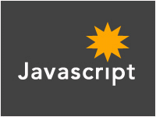
JAVA & Javascript
+
=
Pratik Singh WT unit- 4

Slide 35
Self-Invoking Functions
Function expressions can be made "self-invoking".
A self-invoking expression is invoked (started) automatically, without being called.
Function expressions will execute automatically if the expression is followed by ().
You cannot self-invoke a function declaration.
we have to add parentheses around the function to indicate that it is a function expression:
Example
(function () { let x = "Hello!!"; // I will invoke myself })();
The function above is actually an anonymous self-invoking function (function without name)

Slide 36
Javascript Syntax
Variables:-
variables are declared with the var keyword (case sensitive)
types are not specified, but JS does have types ("loosely typed")
Number, Boolean, String, Array, Object, Function, Null, Undefined
can find out a variable's type by calling typeof
var name = expression; JS
var clientName = "Connie Client";
var age = 32;
var weight = 127.4; JS
Pratik Singh WT unit-4

Slide 37

Contd..
Number type
Vvvvvvvvvvvvvvvvvvvvvvvvvvvvvvvvvvvvvvvvvvvvvvvvvvvvvvvvvvvvvvvvvvvvvvvvvvvvvvvvvvvvvvvvvvvvvvvvvvvvvvvvvvvvvvvvvvvvvv
integers and real numbers are the same type (no int vs. double)
same operators: + - * / % ++ -- = += -= *= /= %=
similar precedence to Java
many operators auto-convert types: "2" * 3 is 6
var enrollment = 99;
var medianGrade = 2.8;
var credits = 5 + 4 + (2 * 3); JS
Pratik Singh 20CS603 and WT 4

Slide 38
Contd..
Comments (same as Java)
identical to Java's comment syntax
recall: 4 comment syntaxes
HTML: <!-- comment -->
CSS/JS/PHP: /* comment */
Java/JS/PHP: // comment
PHP: # comment
// single-line comment
/* multi-line comment */ JS
Pratik Singh 20CS603 and WT 4

Slide 39

Contd..
Math object
methods: abs, ceil, cos, floor, log, max, min, pow, random, round, sin, sqrt, tan
properties: E, PI
var rand1to10 = Math.floor(Math.random() * 10 + 1);
var three = Math.floor(Math.PI); JS
Pratik Singh and WT 4

Slide 40
Operators in JS
Logical operators
> < >= <= && || ! == != === !==
most logical operators automatically convert types:
5 < "7" is true
42 == 42.0 is true
"5.0" == 5 is true
=== and !== are strict equality tests; checks both type and value
"5.0" === 5 is false

Slide 41
Conditional statements
if/else statement (same as Java)
identical structure to Java's if/else statement
JavaScript allows almost anything as a condition
if (condition) {
statements;
} else if (condition) {
statements;
} else {
statements;
}
JS

Slide 42
Contd..
Boolean type
any value can be used as a Boolean
"falsey" values: 0, 0.0, NaN, "", null, and undefined
"truthy" values: anything else
converting a value into a Boolean explicitly:
var boolValue = Boolean(otherValue);
var boolValue = !!(otherValue);
var iLike190M = true;
var ieIsGood = "IE6" > 0; // false
if ("web devevelopment is great") { /* true */ }
if (0) { /* false */ } JS

Slide 43
Java script Loops
for loop (same as Java)
var sum = 0;
for (var i = 0; i < 100; i++) {
sum = sum + i;
} JS
var s1 = "hello";
var s2 = "";
for (var i = 0; i < s.length; i++) {
s2 += s1.charAt(i) + s1.charAt(i);
}
// s2 stores "hheelllloo" JS
Pratik Singh WT Unit-4

Slide 44
Contd..
while loops (same as Java)
break and continue keywords also behave as in Java
while (condition) {
statements;
} JS
do {
statements;
} while (condition); JS
Pratik Singh WT Unit-4

Slide 45

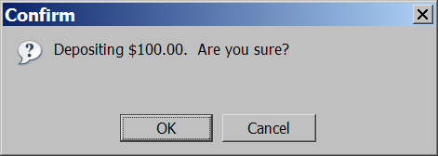
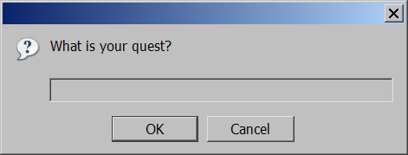
JS Popup boxes
alert("message"); // message
confirm("message"); // returns true or false
prompt("message"); // returns user input string JS
Pratik Singh WT Unit-4

Slide 46
Java script Events
HTML events are "things" that happen to HTML elements.
When JavaScript is used in HTML pages, JavaScript can "react" on these events.
HTML Events
An HTML event can be something the browser does, or something a user does.
Here are some examples of HTML events:
An HTML web page has finished loading
An HTML input field was changed
An HTML button was clicked
Often, when events happen, you may want to do something.
JavaScript lets you execute code when events are detected.
HTML allows event handler attributes, with JavaScript code, to be added to HTML elements.
With single quotes:
<element event='some JavaScript’>
With double quotes:
<element event="some JavaScript">
Pratik Singh WT Unit-4

Slide 47
Common HTML Events
Common HTML Events
Event | Description
onchange | An HTML element has been changed
onclick | The user clicks an HTML element
onmouseover | The user moves the mouse over an HTML element
onmouseout | The user moves the mouse away from an HTML element
onkeydown | The user pushes a keyboard key
onload | The browser has finished loading the page
Pratik Singh WT Unit-4

Slide 48
JavaScript Event Handlers
Event handlers can be used to handle and verify user input, user actions, and browser actions:
Things that should be done every time a page loads
Things that should be done when the page is closed
Action that should be performed when a user clicks a button
Content that should be verified when a user inputs data
And more ...
Many different methods can be used to let JavaScript work with events:
HTML event attributes can execute JavaScript code directly
HTML event attributes can call JavaScript functions
You can assign your own event handler functions to HTML elements
You can prevent events from being sent or being handled
And more ...
Pratik Singh WT Unit-4

Slide 49
JS Arrays
var name = []; // empty array
var name = [value, value, ..., value]; // pre-filled
name[index] = value; // store element JS
var ducks = ["Huey", "Dewey", "Louie"];
var stooges = []; // stooges.length is 0
stooges[0] = "Larry"; // stooges.length is 1
stooges[1] = "Moe"; // stooges.length is 2
stooges[4] = "Curly"; // stooges.length is 5
stooges[4] = "Shemp"; // stooges.length is 5 JS

Slide 50
Working with Arrays
array serves as many data structures: list, queue, stack, ...
methods: concat, join, pop, push, reverse, shift, slice, sort, splice, toString, unshift
push and pop add / remove from back
unshift and shift add / remove from front
shift and pop return the element that is removed
var a = ["Stef", "Jason"]; // Stef, Jason
a.push("Brian"); // Stef, Jason, Brian
a.unshift("Kelly"); // Kelly, Stef, Jason, Brian
a.pop(); // Kelly, Stef, Jason
a.shift(); // Stef, Jason
a.sort(); // Jason, Stef JS

Slide 51
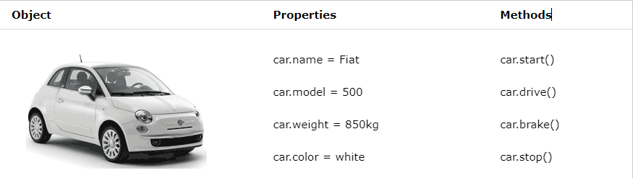
JavaScript Objects
Real Life Objects, Properties, and Methods
In real life, a car is an object. A car has properties like weight and color, and methods like start and stop:
All cars have the same properties, but the property values differ from car to car.
All cars have the same methods, but the methods are performed at different times.

Slide 52

JavaScript Objects
JavaScript Objects
This code assigns a simple value (Fiat) to a variable named car:
let car = "Fiat";
Objects are variables too. But objects can contain many values.
this code assigns many values (Fiat, 500, white) to a variable named car:
const car = {type:"Fiat", model:"500", color:"white"};
Object Definition
You define (and create) a JavaScript object with an object literal:
Example
const person = {firstName:"John", lastName:"Doe", age:50, eyeColor:"blue"};
Spaces and line breaks are not important. An object definition can span multiple lines:
const person = { firstName: "John", lastName: "Doe", age: 50, eyeColor: "blue" };

Slide 53
Contd….
Object Properties
The name : values pairs in JavaScript objects are called properties
Accessing Object Properties
You can access object properties in two ways:
objectName.propertyName
Object Methods
Objects can also have methods.
Methods are actions that can be performed on objects.
Methods are stored in properties as function definitions.
Property | Property Value
firstName | John
lastName | Doe
age | 50
eyeColor | blue

Slide 54

JavaScript Function Definitions
Javascript functions are defined with function keyword
You can use a function declaration or a function expression
Function Declarations
function functionName(parameters) { // code to be executed }
Declared functions are not executed immediately. They are "saved for later use", and will be executed later, when they are invoked (called upon).
function myFunction(a, b) { return a * b; }
Function Expressions
A JavaScript function can also be defined using an expression
A function expression can be stored in a variable:
const x = function (a, b) {return a * b};

Slide 55
Cont….
After a function expression has been stored in a variable, the variable can be used as a function:
const x = function (a, b) {return a * b}; let z = x(4, 3);
The function above is actually an anonymous function (a function without a name).
Functions stored in variables do not need function names. They are always invoked (called) using the variable name.
The Function() Constructor
Function can be defined with a built-in java script function constructor called function()
const myFunction = new Function("a", "b", "return a *b"); let x = myFunction(4, 3);

Slide 56
Self-Invoking Functions
Function expressions can be made "self-invoking".
A self-invoking expression is invoked (started) automatically, without being called.
Function expressions will execute automatically if the expression is followed by ().
You cannot self-invoke a function declaration.
we have to add parentheses around the function to indicate that it is a function expression:
Example
(function () { let x = "Hello!!"; // I will invoke myself })();
The function above is actually an anonymous self-invoking function (function without name)

Slide 57
Arrow Functions
Arrow functions allows a short syntax for writing function expressions.
Example :
// ES5 var x = function(x, y) { return x * y; } // ES6 const x = (x, y) => x * y;
Arrow functions do not have their own this. They are not well suited for defining object methods
Arrow functions are not hoisted. They must be defined before they are used
Using const is safer than using var, because a function expression is always constant value.
You can only omit the return keyword and the curly brackets if the function is a single statement. Because of this, it might be a good habit to always keep them:
Example
const x = (x, y) => { return x * y };

Slide 58
JavaScript Function Parameters
A JavaScript function does not perform any checking on parameter values (arguments).
function functionName(parameter1, parameter2, parameter3) { // code to be executed }
Function parameters are the names listed in the function definition.
Function arguments are the real values passed to (and received by) the function
Parameter Rules
JavaScript function definitions do not specify data types for parameters.
JavaScript functions do not perform type checking on the passed arguments.
JavaScript functions do not check the number of arguments received.
Default Parameters
If a function is called with missing arguments (less than declared), the missing values are set to undefined
function myFunction(x, y) { if (y === undefined) { y = 2; } }

Slide 59
Topic Objective/Outcome
Topics: Object de-structuring, Spread and Rest Operator, Typescript fundamentals, Typescript OOPs- Classes, Interfaces, Constructor etc. Decorator and Spread Operator,
Difference == & ===, Asynchronous Programming in ES6, Promise Constructor, Promise with Chain, .(CO4 )
Objective of the above topics:
To learn the fundamentals of typescript
To learn the creation of object in ES6.
To get the knowledge about Programming in ES6.
To learn the OOPS concepts by using ES6 Programming.
To learn the concept of ES6 constructor chaning

Slide 60
TypeScript Fundamentals
TypeScript is an open-source language that provides support for building enterprise scale JavaScript applications. Although several patterns exist that can be used to structure JavaScript,
TypeScript is a programming language developed by Microsoft that is a superset of JavaScript. It is designed for developing enterprise scale JavaScript applications
TypeScript provides container functionality that object-oriented developers are familiar with, such as classes and modules.
It also supports strongly-typed code to ensure inappropriate values aren't assigned to variables in an application.

Slide 61
Difference between JavaScript & TypeScript
The main difference is that JavaScript is a scripting language used to make interactive web pages and applications, while TypeScript is a superset of JavaScript. Other differences include:
TypeScript code needs to be compiled, but JavaScript does not
TypeScript uses types and interfaces while JavaScript does not
TypeScript has some additional features for functions
TypeScript has a certain feature of prototyping that JS does not
Maintaining a huge code in JavaScript is extremely difficult.

Slide 62
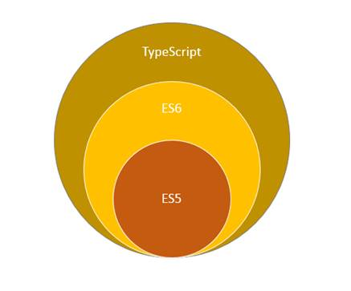
Key features of Typescript
TypeScript is a free and open-source programming language developed and maintained by Microsoft.
It is a superset of JavaScript, So you can write JavaScript code in typescript.
Enables static typing and class-based object-oriented programming to JavaScript.
Another key feature is that Angular 2 is written in typescript

Slide 63
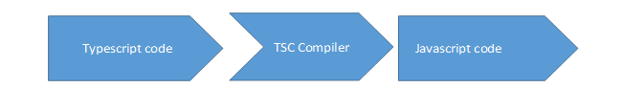
How typescript works
Typescript compiler converts code written in typescript to JavaScript,
Supported Editors We can write typescript using any one of the below editors.
Visual Studio.
Node.js
Sublime Editor
TypeScript play ground

Slide 64
JavaScript ES6
JavaScript ES6 (also known as ECMAScript 2015 or ECMAScript 6) is the newer version of JavaScript that was introduced in 2015
ECMAScript 2015 or ES2015 is a significant update to the JavaScript programming language. It is the first major update to the language since ES5 which was standardized in 2009. Therefore, ES2015 is often called ES6.
ECMAScript is the standard that JavaScript programming language uses. ECMAScript provides the specification on how JavaScript programming language should work.

Slide 65
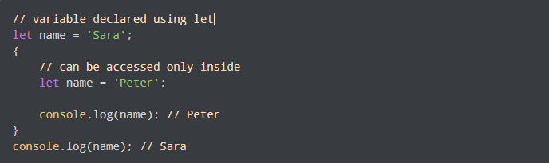
ES6 Cont…
JavaScript let
JavaScript let is used to declare variables. Previously, variables were declared using the var keyword
The variables declared using let are block-scoped. This means they are only accessible within a particular block. For example,

Slide 66

ES6 Cont…
JavaScript const
The const statement is used to declare constants in JavaScript. For example,
Once declared, you cannot change the value of a const variable

Slide 67
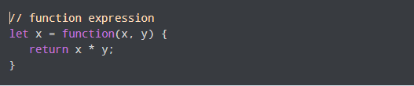

ES6 Cont…
JavaScript Arrow Function
In the ES6 version, you can use arrow functions to create function expressions. For example,
This function
can be written as

Slide 68
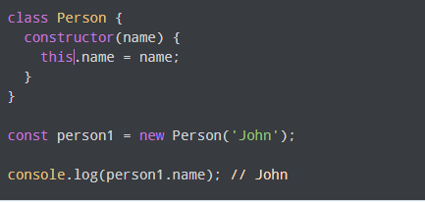
ES6 Cont…
JavaScript Classes
JavaScript class is used to create an object. Class is like a constructor function. For example,
class Person {
constructor(name) {
this.name = name;
}
}
Keyword class is used to create a class. The properties are assigned in a constructor function. Now you can create an object.

Slide 69
Daily Quiz
Q1. Java script is an _______ language?
(A) object oriented
(b) object base
© procedural
(d) None of these
Q2.Which of the following keywords is used to define a variable in JavaScript?
(a) let
(b) var
(C) both A & B
(d) None of the above
Q3.How can a datatype be declared to be constant type ?
(A) var
(b) const
© let
(D) constant

Slide 70
Daily Quiz(cont..)
Q4.Java script is ideal to
(A)make computations in HTML simpler
(B) minimize storage requirements on the web server
(c) increase the download time for the client
(D) none of the mentioned
Q5.The basic difference between javascript & java is
(A)There is no difference
(B). Functions are considered as fields
©. Variables are specific
(D). Functions are values, and there is no hard distinction between methods and fields
Q6. Which of the following is not javascript framework?
Node
Vue
React
Cassandra

Slide 71
Daily Quiz(cont..)
Q7. Arrays in JavaScript are defined by which of the following statements?
It is an ordered list of values
It is an ordered list of objects
It is an ordered list of string
It is an ordered list of functions
Q8.Which of the following is not JavaScript data types?
Null type
Undefined type
Number type
All of the mentioned
Q9.Where is Client-side JavaScript code is embedded within HTML documents? a) A URL that uses the special javascript:code b) A URL that uses the special javascript:protocol c) A URL that uses the special javascript:encoding d) A URL that uses the special javascript:stack

Slide 72
Weekly Assignment
Where can we place JavaScript ? [CO3]
Explain screen output and keyboard input method in JavaScript. [CO3]
Define instance of operator in JavaScript. [CO4]
Explain various datatypes used in JavaScript. [CO4]
Write a JavaScript to find factorial of a number.[CO3]
What is a DTD ? Mention its types. [CO3]
What are composite datatypes in Java Script ? [CO3]
What are the different levels of headings in HTML ? [CO3]
How to create date object in JavaScript ? Explain any four methods of JavaScript date object. [CO4]
What are the different ways that we can include JavaScript to a XHTML document. [CO4]

Slide 73
MCQ s
[Q1.]Which of the following methods/operation does JavaScript use instead of == and !=?
JavaScript uses equalto()
b) JavaScript uses equals() and notequals() instead
c) JavaScript uses bitwise checking
d) JavaScript uses === and !== instead
[Q2.] Why is JavaScript Engine needed?
Both Compiling & Interpreting the JavaScript
b) Parsing the JavaScript
c) Interpreting the JavaScript
d) Compiling the JavaScript
[Q3]. What would be the result of 2+5+”3″?
5
7
73
37

Slide 74
MCQ s(Cont..)
[Q4]. Name some of the JavaScript Frameworks?
Angular
React
Vue
All of them
[Q5]. What is the difference between the operators ‘==‘ & ‘===‘?
[Q6]. In how many ways a JavaScript code can be involved in an HTML file?
Inline
Internal
External
All of them
[Q7] List out the different ways an HTML element can be accessed in a JavaScript code.
getElementById(‘idname’): Gets an element by its ID name
getElementsByClass(‘classname’): Gets all the elements that have the given class name.
getElementsByTagName(‘tagname’): Gets all the elements that have the given tag name.
querySelector(): This function takes CSS style selector and returns the first selected element.
All of them.

Slide 75
MCQ s(Cont..)
For largest level of heading which tag is used? A) <h1> B) <h6> C) <heading> D) <head> API stands for
a)Application Programming Interface
b) Application Programming Index
c) Applet Programming Interface
(d) None of these
For handling user interaction ___side scripting is useful
Server
b)Client
c)Server & Client
d) None of these

Slide 76
Glossary Questions
JAD stands for
Joint Application Development
Joint Application Difference
Joint Application Demo
none of these
Java script is scripting language introduce by
IE
Microsoft
Netscape
SunJava
___ operator calculates the remainder by dividing two integers.
/ b) rem c) ^ d) %

Slide 77
Glossary Questions
Which tag is used for smallest heading ……………… protocol stack.
Marquee tag has following attributes
a)behavior
b)direction
c)position
d)both a and b.
The word internet stands for ____
International Network
b) Internal Network
c) Intermediate Network
d) none of these
_____ is used to create a new paragraph
(a) <from> (b) <img> (c) <p> (d)< marque>

Slide 78

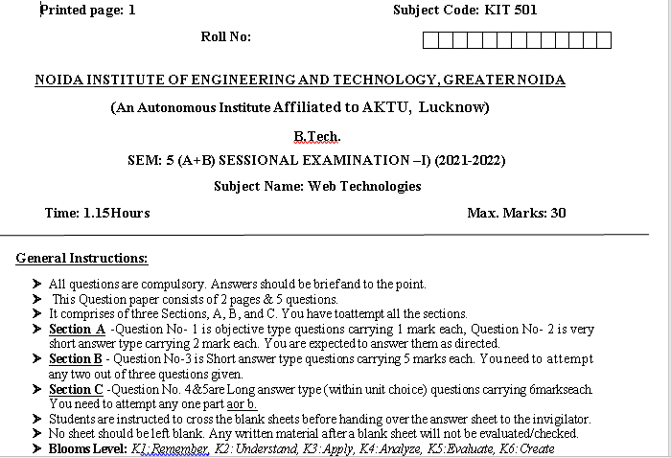
Sessional Papers

Slide 79
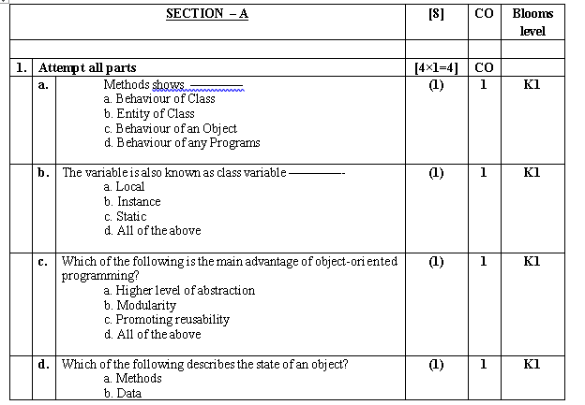
Sessional Papers

Slide 80
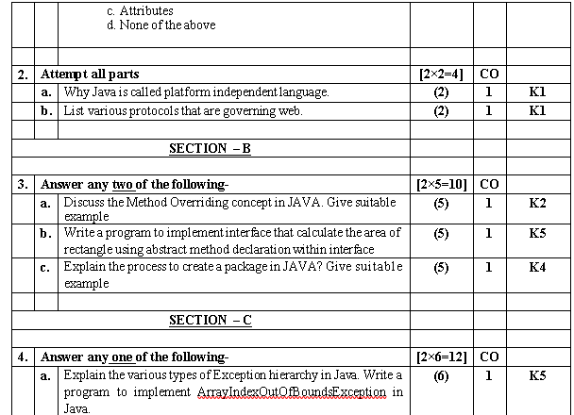
Sessional Papers

Slide 81
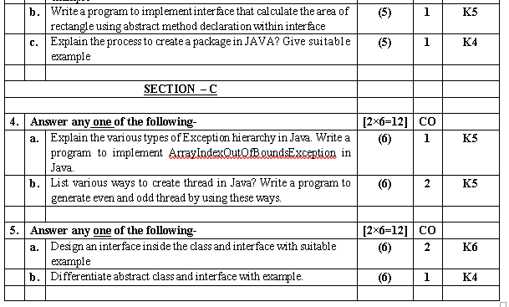
Sessional Papers

Slide 82
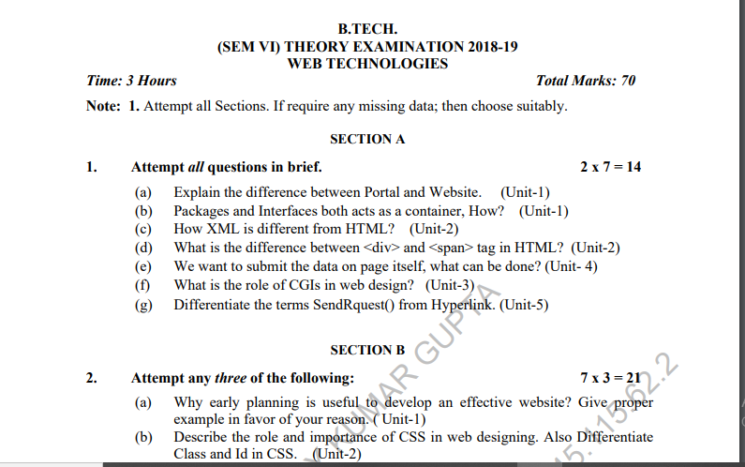
Old Question Paper

Slide 83
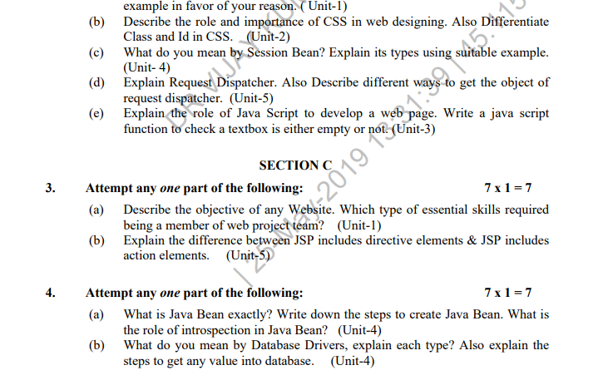
Old Question Paper(cont..)

Slide 84
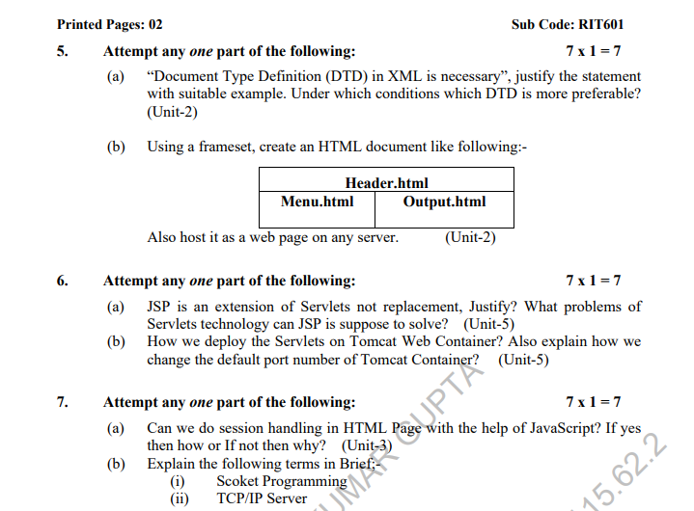
Old Question Paper(cont..)

Slide 85
Expected Questions for University Exam
Explain the importance of JavaScript. Write a java script to manipulate array
Explain relational, logical and athematic operators.
Explain if-else statement in java script with examples.
Write a java Script for counting Odd, even and prime numbers from 1 to 100
Write a java script to calculate the area of the triangle
Write a java script to find factorial of given number.
If a=10 and b=20 write a java script to swapping of these two numbers
Write a script to display sum of first 10 numbers
write a java script to validate phone number

Slide 86
Expected Questions for University Exam
Write a Java Script to calculate the average of three numbers.
Write a java script for finding the greater number between two numbers.
Write a Java Script for on change event.
Which java script operator calculates the remainder by dividing two integers.
Which tag is used for smallest heading .
which tag is used to left align the content is table cell.
which tag is used to left align the content is table cell.

Slide 87
References
Burdman, Jessica, “Collaborative Web Development” Addison Wesley
Xavier, C, “ Web Technology and Design” , New Age International
Ivan Bayross,” HTML, DHTML, Java Script, Perl & CGI”, BPB Publication

Slide 88
Recap of Unit 4
Covered What is JavaScript how JavaScript is different than HTML,CSS.
Covered variables, constant, keywords, operators etc.
Discussed various java script objects, function , function parameters, function arguments etc.
Covered JS script loop, js popup boxes, JS event etc.
Discussed JS array, strings, strings method etc.

Slide 89
NPTEL video / Other study links
Unit 1 | https://youtu.be/96xF9phMsWA
 | https://youtu.be/Zopo5C79m2k
 | https://youtu.be/ZliIs7jHi1s
 | https://youtu.be/htbY9-yggB0
Unit 2 | https://youtu.be/vHmUVQKXlVo
 | https://youtu.be/qz0aGYrrlhU
Unit 3 | https://youtu.be/1Rs2ND1ryYc
Unit 4 | https://youtu.be/-qfEOE4vtxE
 | https://youtu.be/PkZNo7MFNFg
Unit 5 | https://youtu.be/_GMEqhUyyFM

Slide 90
Thank You

